Slide 1
Hive Queries on Unstructured Data Sets
George Kotzabassis

Slide 2
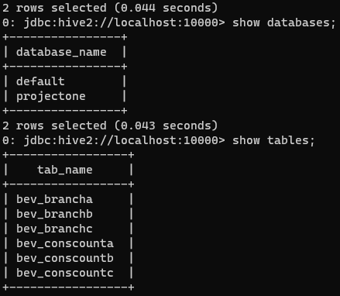
Opening Notes
All tables are comma delimited, each with two parameters
Bev_branch tables have drinks and branches
Bev_conscount tables have drinks and quantities
The tables are not directly correlated, so each branch customer count is the set of available permutations
I added three new tables:
bev_branch_all
cons_count_all
cumulative_set

Slide 3
Utilities
Hadoop Distributed File System Foundational Storage System Containing Project Data
Hive and DBeaver Data Warehousing Tools Included to Perform Query Commands on the Data

Slide 4
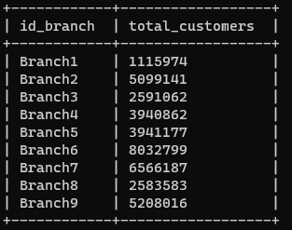
Problem One
Determine the number of customers in Branches 1 and 2

Slide 5


Problem Two
Problem: Determine the most sold drink in Branch 1 and the least in 2

Slide 6
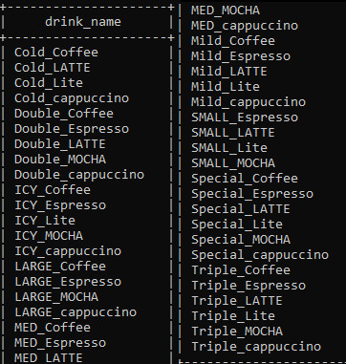
Problem Three Part 1
Determine the set of beverages available on Branches 10, 8, and 1

Slide 7
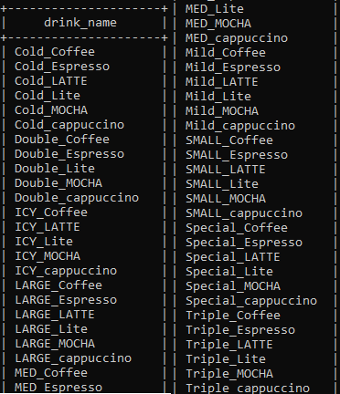
Problem 3 Part 2
Determine the set of common beverages between Branches 4 and 7

Slide 8
Problem Four - Part One Statements
Partition
Index
View

Slide 9
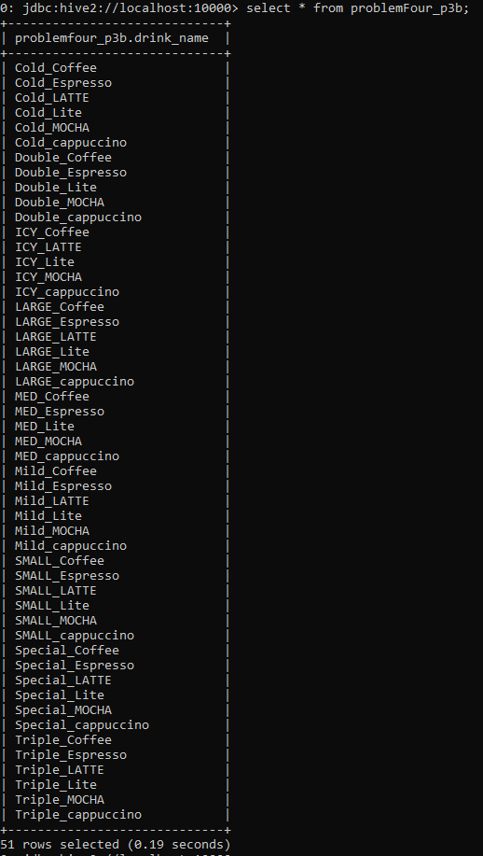
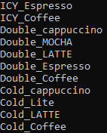
Project Four - Part One Results
Partition v
View >

Slide 10
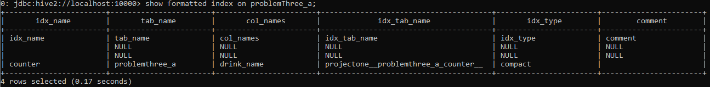
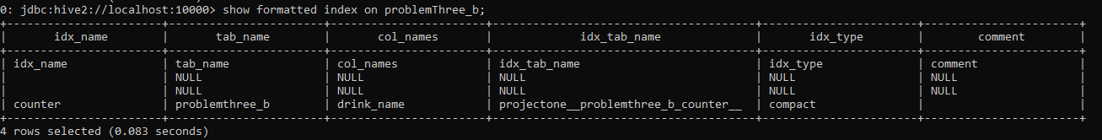
Project Four - Part One and Two Index Results
Indexes

Slide 11
Problem Four - Part Two Statements
Partition
Index
View

Slide 12
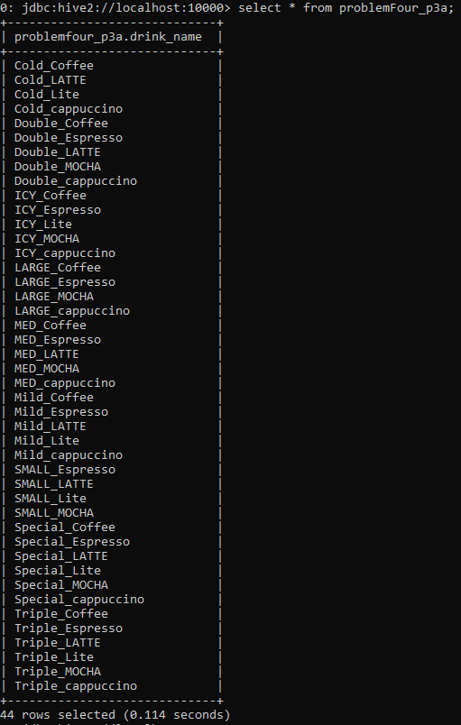
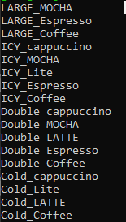
Problem Four - Part Two Results
Partition v
View >

Slide 13
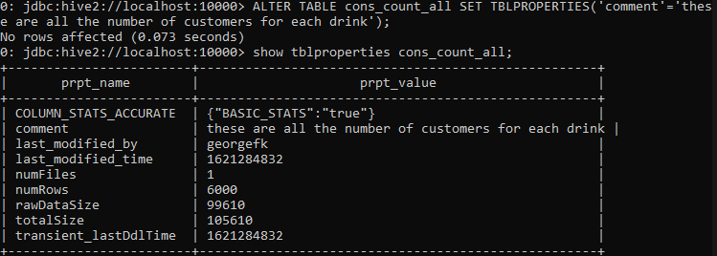
Problem Five - Part One
Demonstration of ALtering Table Properties to Add Comments

Slide 14
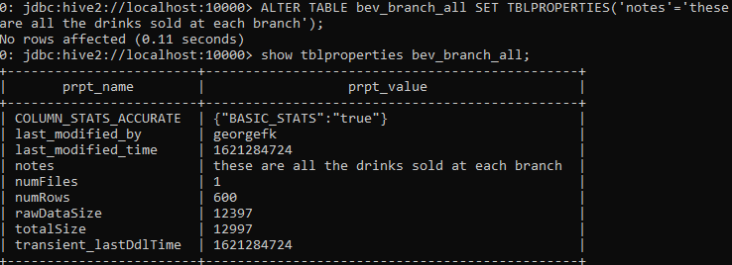
Problem Five - Part Two
Demonstration of ALtering Table Properties to Add Notes

Slide 15
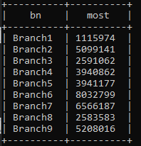
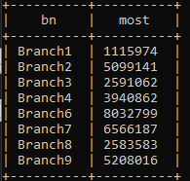
Problem Six
Remove Branch 5 from the Full Table Set in Problem One Recall in Problem One we create a table called p6_target
Before After

Slide 16
Questions?

